Slide 1


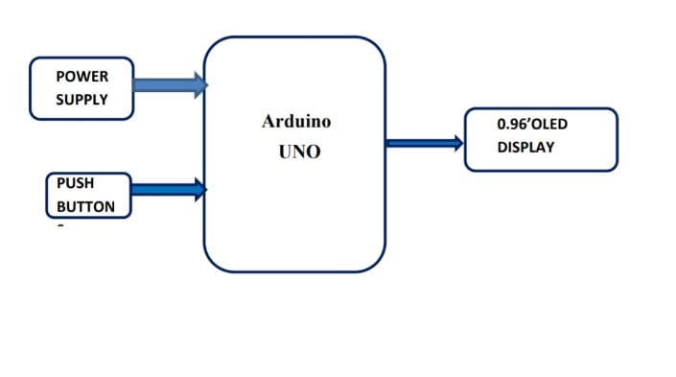
CMR College of Engineering & Technology (UGC Autonomous)
Kandlakoya, Medchal Road, Hyderabad 501401. Centre for Engineering Education & Research (CEER)
PONG GAME WITH ARDUINO
ABSTRACT: The classic pong game was a sensation which was first developed by Atari because it successfully
combined digital electronics and TV display to create a new medium for gameplay. But the digital electronics occupied a lot of space and also was very costly and later when they released the Home Pong Consoles we were able to play it in our hands itself but, it used microprocessor for doing the project
DESCRIPTION:
The main components used in our circuit is the
Arduino UNO microcontroller and 0.96’ OLED
Display and the other components used in this
circuit are the Bread Board which is used to
build then electronic circuit, jumper wires
(male – male) are used for connecting the
components in this electronic circuit and two
push buttons which helps in the vertical
movement of the paddle to hit the ball.
CONCLUSION
ARCHITECTURE:
This prototype is safe to use and there will be
no risk of leakage of user data, it is budget friendly and in this modern world there are many
games which are addictive, risky and age restricted but, this Classic Pong Game does not have
any such restrictions, this game can be played by people of any age group and there is no risk of
addiction or anything else.
Faculty:
TEAM 5
21H51A0506-J.Akansh
21H51A0512-Manas
21H51A0523-S.Sumith
Mr. Kayyam Sathish (Assist. Prof)
Mr. M. Raman Kumar(Assist. Prof)
Mr. B. Kondalu (Assist. Prof)
21H51A0505-G.Pavani
21H51A0525-T.Maheshwari

